Slide 1
INDUSTRIAL AUTOMATION TECHNIQUE USING DEEP LEARNING
​

Slide 2
PRESENTED BY
Debasish Kumar Baidya - 10900120192
Prerana Patra - 10900120190
Tushar Jolly – 10900119017
Akash Mahajan – 10900119016
MENTOR
Mrs. Runa Chatterjee

Slide 3
INDEX
Introduction​
Existing System
​Requirement Specification
Flow Charts
ER Diagram
Aim of the Project
Example of Implementation of the project
Future Scope
Conclusion
References

Slide 4
INTRODUCTION
Industrial Automation Technique project is base on deep learning
This project include two parts hardware and software .
This project is based on image detection technique
Object detection process not only help in detecting the object’s image but also gather the information and data for unique identification of object.
This technique is use in production factory like Logistic supply chain companies ,FMCG, Packaging companies etc.
This technique is very useful and save a lot of time and human error .

Slide 5
EXISTING SYSTEM
Model Training
Object tracking
Counting objects and inserting data into database
Showing data in Web Page

Slide 6
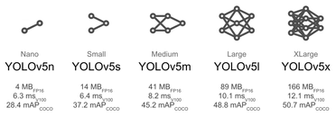
Types of YOLO V5

Slide 7
REQUIREMENT SPECIFICATION
Software Python Google Colab CVAT YOLO V5 Strong SORT HTML ,CSS, JS,PHP phpMyAdmin
Hardware Johnson Motor 12 volt adapter Rack & Pinion

Slide 8
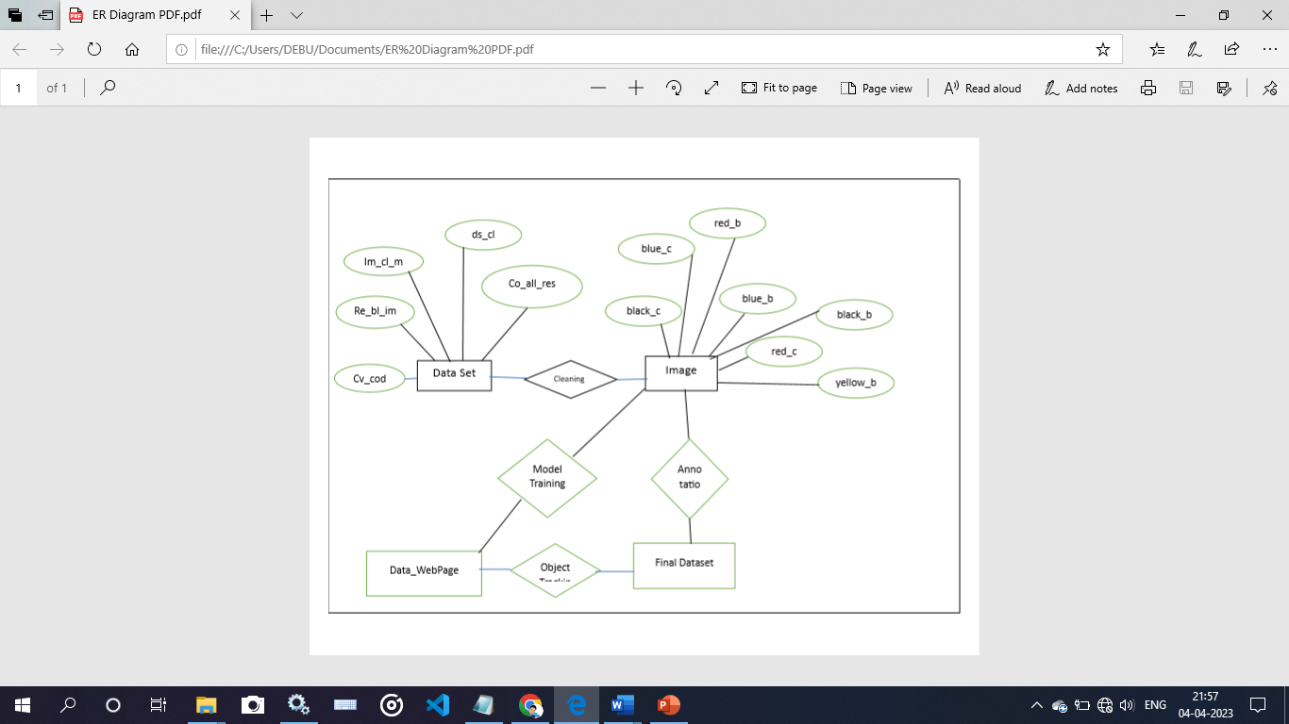
ER Diagram

Slide 9
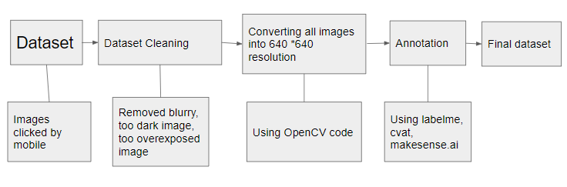
FLOW CHART
DATASET FLOW CHART

Slide 10
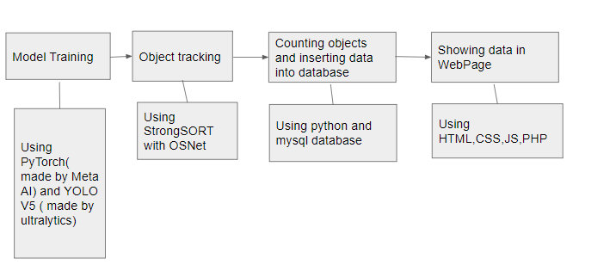
FLOW CHART
MAIN FLOW CHART

Slide 11
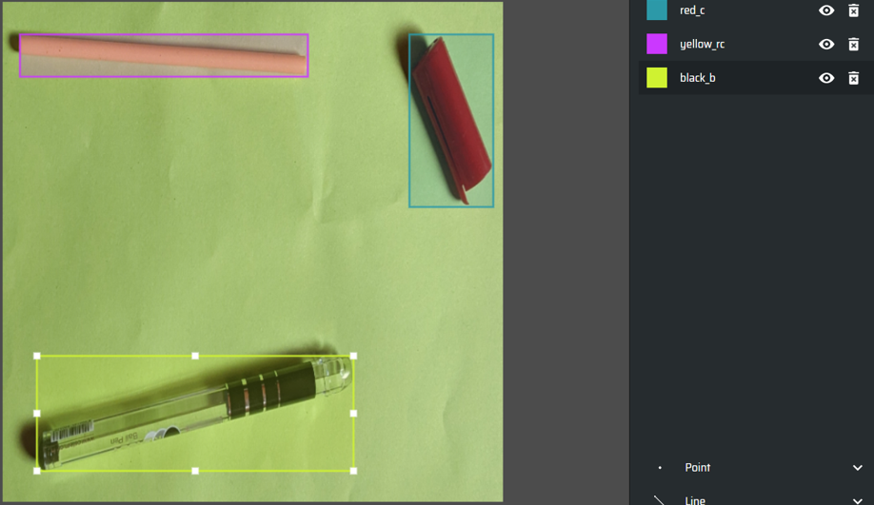
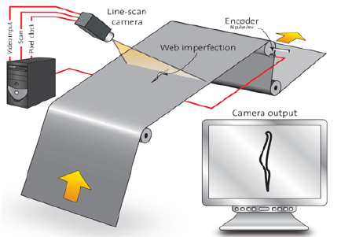
DATA ANNOTATION
OBJECT DETECTION

Slide 12
EXAMPLE OF IMPLEMENTATION OF THE PROJECT
We are going to detect a particular object in this project we have take a PEN as an object .
Here we have divided the pen into four different parts namely PEN BODY , PEN CAP ,PEN REFILL COVER AND PEN REFILL .
There will be four different colors of pen i.e. RED ,YELLOW, BLUE & BLACK.
At first we have trained our system by feeding the data of 1500 images of different parts of the pen at various angles .
In our working model there is a conveyor belt that will carry the pen and its parts .
A camera will be fitted at a suitable angle that it can check each and every object .
The camera system will detect the object and will identify each and every specific object .
After detecting the data will be collected and stored in our database .

Slide 13
AIM OF THE PROJECT
This project is mainly based on Industrial Automation Technique
In this project we have use a production line of PENs for our reference .
After manufacturing of the pens all pen comes in a same conveyer belt unseparated .
Before further process of packaging , the camera fitted over the conveyor belt will detect each and every object and store the data
For example – It will detect red pen body ,black cap , yellow refill cover and refill .
After that it will keep a count of each and every object in the data base for further process .
This will help in accurate output of pens from the factory .
It will remove human errors and better efficiency of the factory.

Slide 14
FUTURE SCOPE
Industrial Automation Technique is very useful for the supply chain industry . From automobile industry to FMCG industry. The process reduces human error and is very efficient. Time is very precious and the technique can save lot. So that industry can focus on their product research and development.
In supply chain industry scanning and data collection is a major work which can be automated using the deep learning process.

Slide 15
CONCLUSION
In conclusion, industrial automation has led us to develop comprehensive strategies for Industry 4.0. Although, manufacturers would soon have to prepare for the next generation, Industry 5.0.
It is a further advanced trend that will focus on personalization and immediate customer service. As a result, it will integrate people with “cobots” or collaborative robots.

Slide 16
REFERENCES
https://github.com/ultralytics/yolov5
https://github.com/mikel-brostrom/Yolov5_StrongSORT_OSNet
https://www.makesense.ai/
https://www.tutorialspoint.com/python_deep_learning/index.htm
https://www.udemy.com/course/deeplearning_x/
https://www.mathworks.com/discovery/deep-learning.html

Slide 17
THANK YOU

